Slide 1
Story
File created on: 12-07-2020 17:35:16

Slide 2
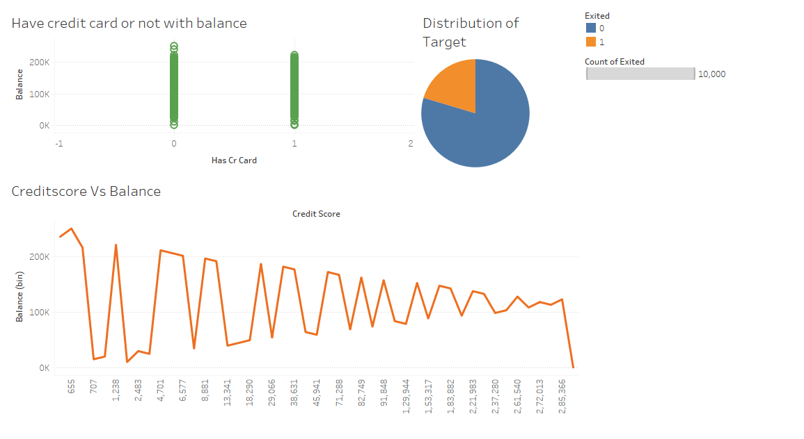
BANK CUSTOMER WILL CHURN OR NOT
1. Target is imbalanced
2. No linear relation between balance and credit score

Slide 3
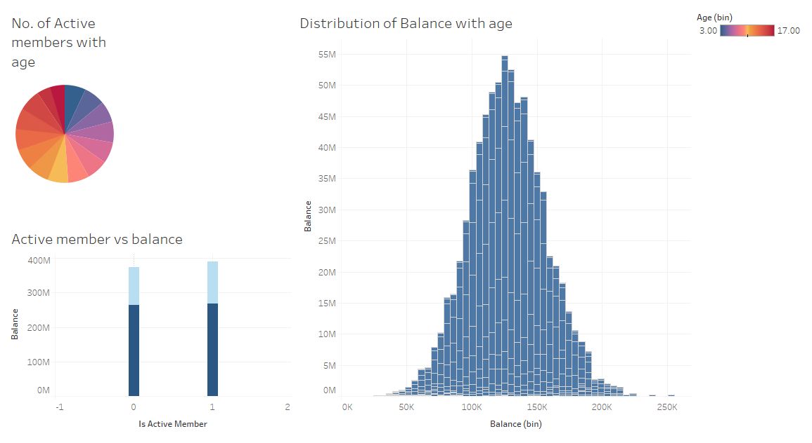
BANK CUSTOMER WILL CHURN OR NOT

Slide 4
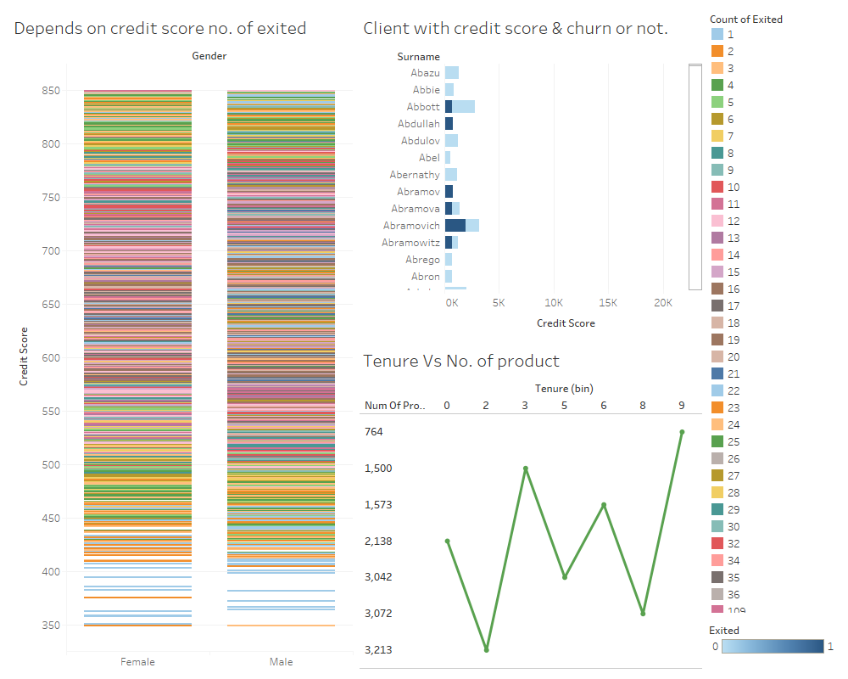
BANK CUSTOMER WILL CHURN OR NOT

